Slide 1
Supply Chain Management System Analysis
By: Michael McGuigan

Slide 2

About The Business
Shipping company utilizing a Supply Chain Management System (SCMS) for data collection.
Global delivery of pharmaceutical products.
Test Kits
Tablets
Capsules
Oral Solutions

Slide 3
About The Data
Data collected by the SCMS consists of:
Over 10,000 shipments with 33 metrics tracked
collected between 2006 and 2015
Categorical data
Lots of categories with low frequency
Numerical data
Large variability in values
Mix of float and string values

Slide 4
Categorical Data
Country
Fulfill Via
Direct Drop, Regional Distribution Centers
Vendor INCO Term
Used to communicate breakdown of responsibility on delivery
Shipment Mode
Product Group
Vendor
Brand
Dosage Form
Manufacturing Site

Slide 5
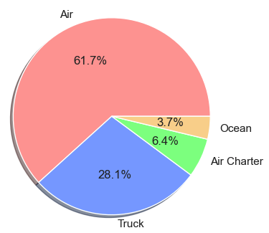
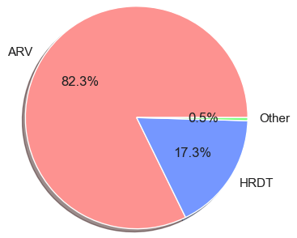
Categorical Data
Shipment Mode
Product Groups
ARV = Antiretroviral
HRDT = HIV Rapid Diagnostic Test Kit

Slide 6
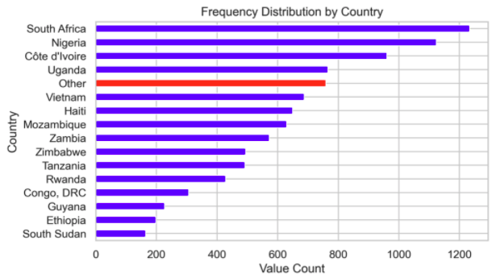
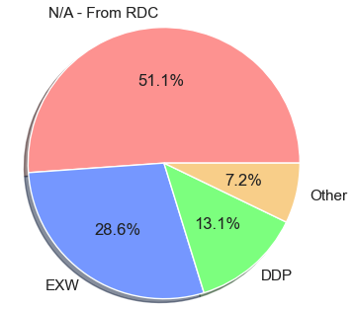
Categorical Data
Countries
Vendor INCO Term
RDC = Regional Distribution Center
DDP = Delivery Duty Paid
EXW = Ex Works

Slide 7
Numerical Data
Scheduled Delivery Date
Delivered To Client Date
Line Item Quantity
Line Item Value
Pack Price
Weight (Kg)
Freight Cost (USD)

Slide 8
Business Question and Objective
What are the predictors of a late or early delivery?
How can we minimize late and early deliveries?

Slide 9
Methodology Target Variable = Delivery Days Off of Scheduled
Categorical Data
Clean the data
Drop rows with empty cells
Group low frequency categories
Create dummy variables
Avoid multicollinearity
Randomly split the data
Training data (80%)
Test data (20%)
Numerical Data
Clean the data
Drop rows with empty cells, non-numeric values, or outliers
Format dates
Normalize the data
Randomly split the data
Training data (80%)
Test data (20%)

Slide 10
Methodology – Multiple Linear Regression
Run Multiple Linear Regression (MLR)
Categorical vs numerical data
Comparison by coefficients
Predict target variable of test data
Calculate R² coefficient
Measure of how well the regression predictions approximate the real data points.
Scale: 0 to 1

Slide 11
Findings - MLR
Categorical Variables
R² = 0.142
Largest coefficients
Shipment Mode, Vendor INCO Term, and Product Group
R² = 0.135
Numerical Variables
R² = 0.053
Largest coefficients
Pack Price, and Weight
R² = 0.052
This shows that the other variables do not appear to be predictors of a late delivery.

Slide 12
Findings
Low R² values (not statistically significant) for both categorical and numerical data.
We are unable to reject the null hypothesis.
Null hypothesis: The variables are not predictors of early or late delivery.
This means we cannot determine the predictors of a late delivery given our data.
“Absence of evidence is not evidence of absence.”
Quote by Martin Rees, British astrophysicist and cosmologist.
General trends in data

Slide 13
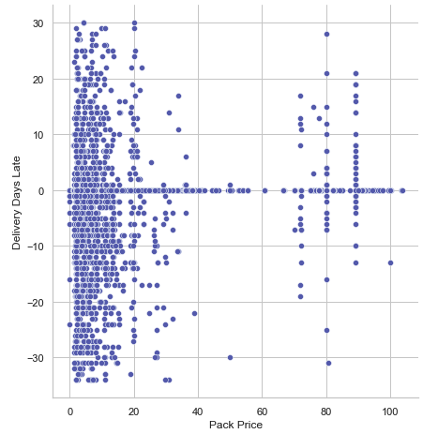
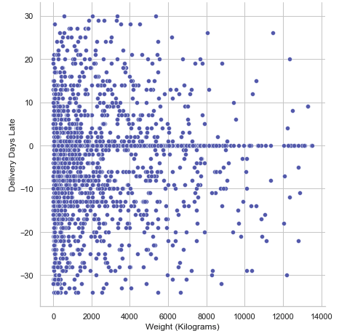
Findings – General Trends
Pack Price vs Delivery Days Late
Weight (Kg) vs Delivery Days Late

Slide 14
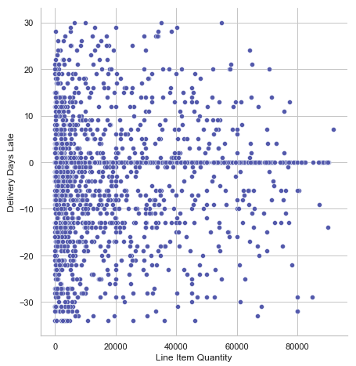
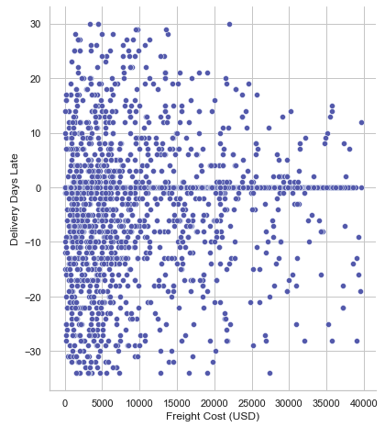
Findings – General Trends
Line Item Quantity vs Delivery Days Late
Freight Cost (USD) vs Delivery Days Late

Slide 15
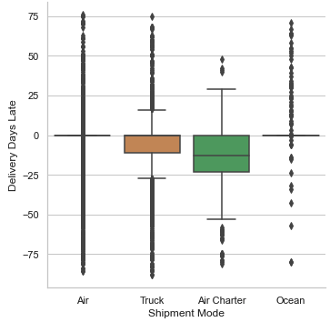
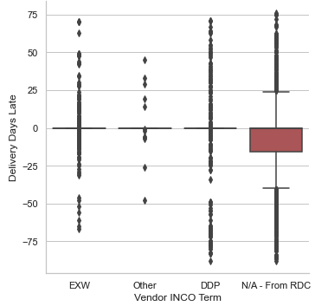
Findings – General Trends
Shipment Mode vs Delivery Days Late
Vendor INCO Term vs Delivery Days Late

Slide 16
Conclusion & Next Steps
While we failed to determine the predictors of a late delivery, we can see a few general trends in the data such as:
Larger and more expensive shipments tend to have more on time deliveries.
Truck and Air Charter delivery methods tend to have more variability in meeting the scheduled delivery date.
We can use these trends to minimize late or early deliveries.
Recommendations and Next Steps
Talk to customers
Quality control methods for smaller shipments

Slide 17
Thank you!
Questions?

